Slide 1
Hardware: Locomotions & Mechanical Design (2-ACTUATORS)
Task for 11 Apr 22 (Online Lecture)

Slide 2
Hardware Components that move the Robots i) Basic Motion Principle ii)Hardware Components (Specification,Brands and Price)
1) Stationary Robots
a) Omron forpheus robot
2) Wheeled Robots & Tracked Robots
a) Single wheel BB-8
b) 4WD Omni-Directional Mobile Robot
c) Wall Climbing Robot (Metal vs Wall vs Glass)
3) Legged
a) Humanoid Robot (BIOLOID)
4) Swimming
a) Fish robot
b) Underwater glider robot
5) Others
a) Kilobot

Slide 3
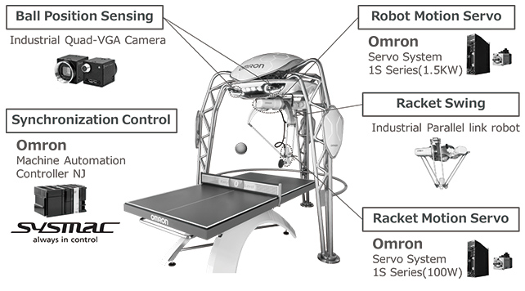
1) Stationary Robots a) Omron Forpheus robot

Slide 4
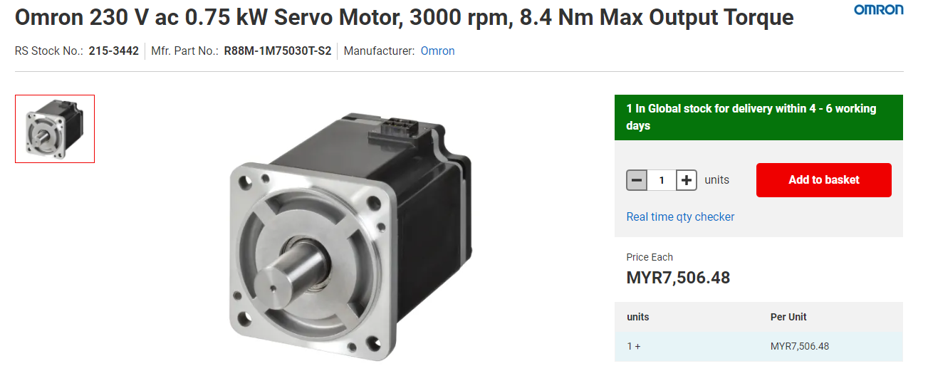
1) Stationary Robots a) Omron Forpheus robot hardware

Slide 5
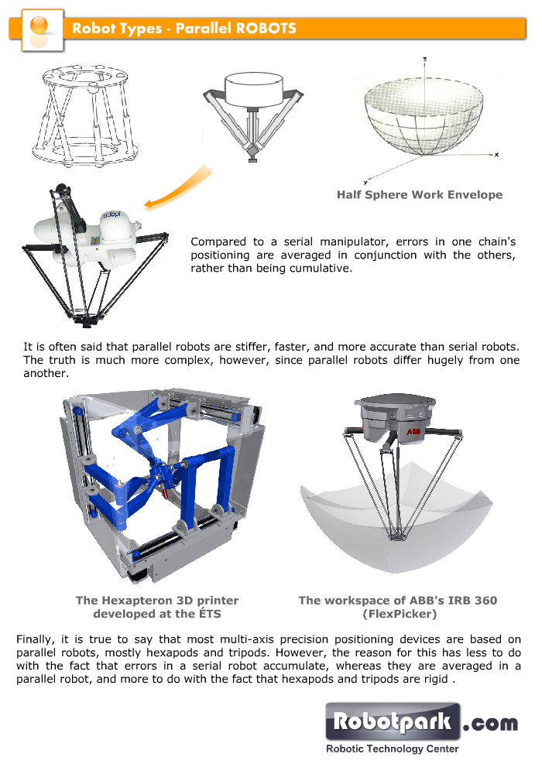
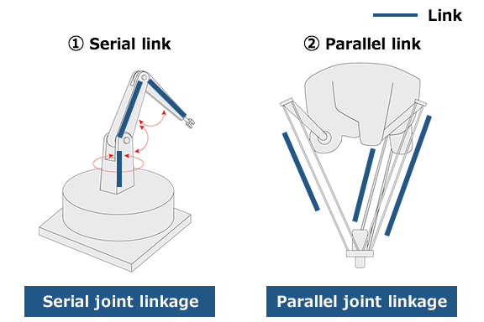
1) Stationary Robots a) Omron Forpheus robot Principle

Slide 6
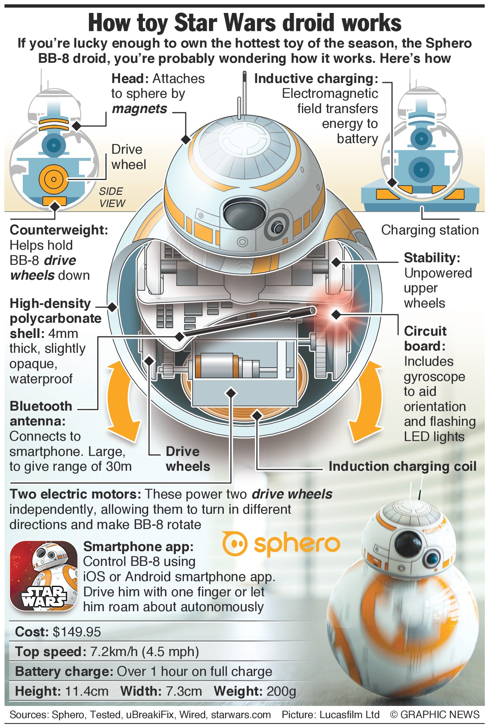
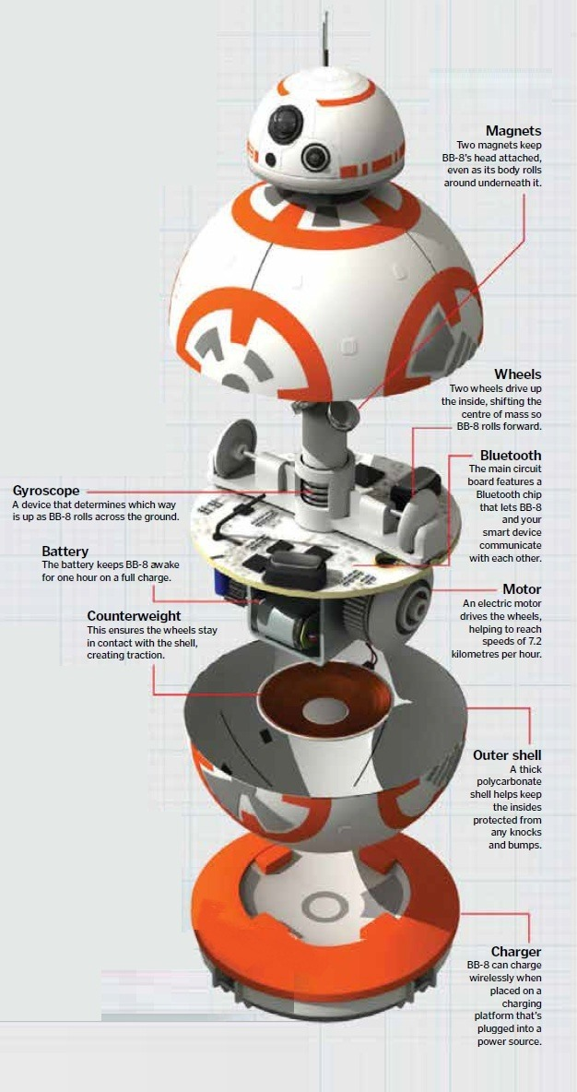
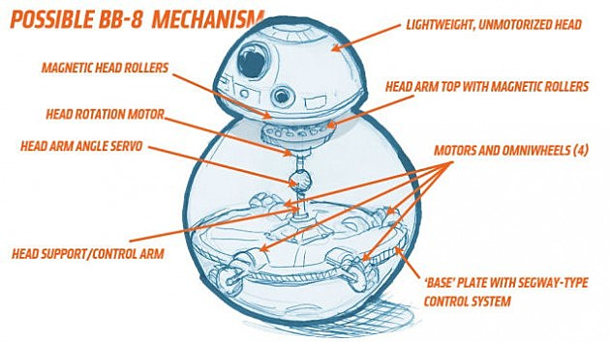
2) Wheeled Robots & Tracked Robots a) Single wheel BB-8

Slide 7
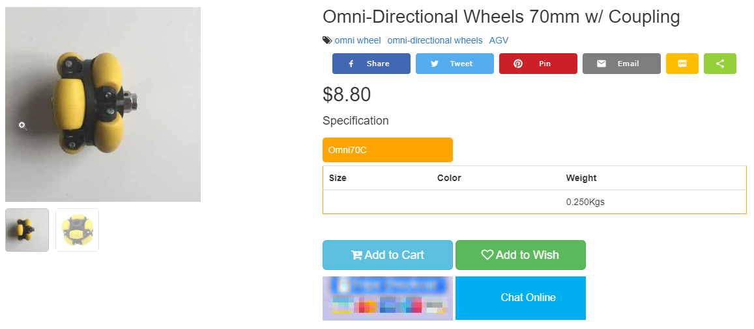
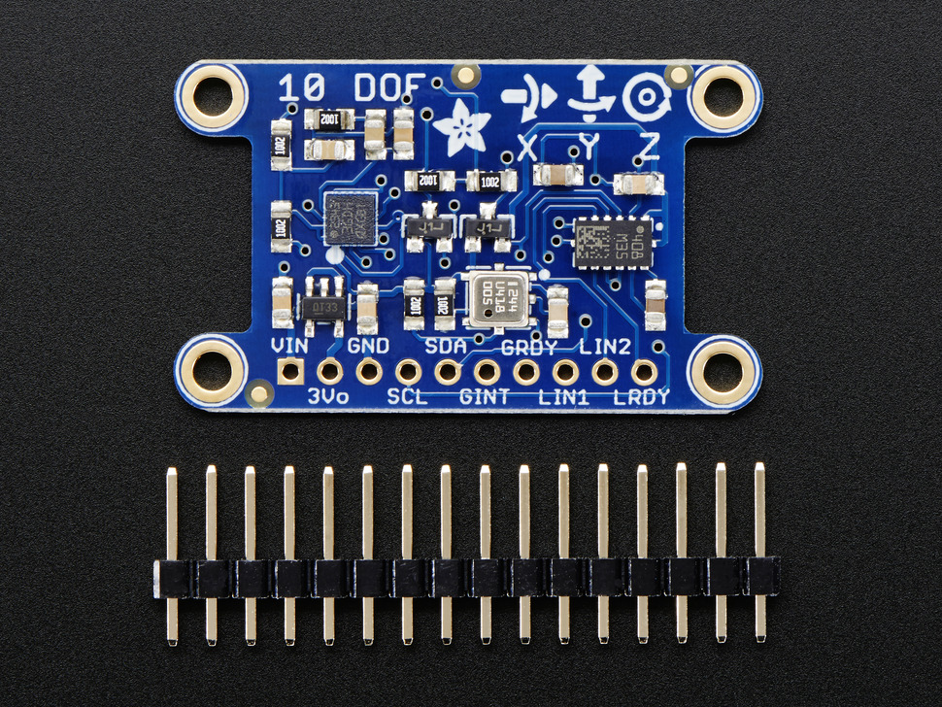
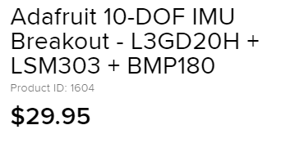
2) Wheeled Robots & Tracked Robots a) Single wheel BB-8 hardware

Slide 8
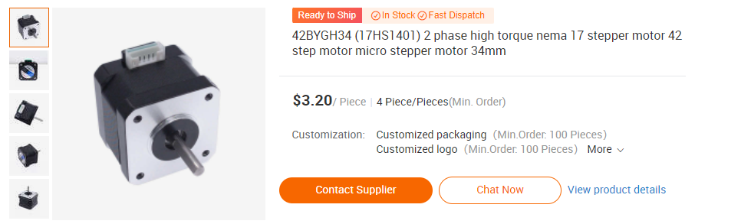
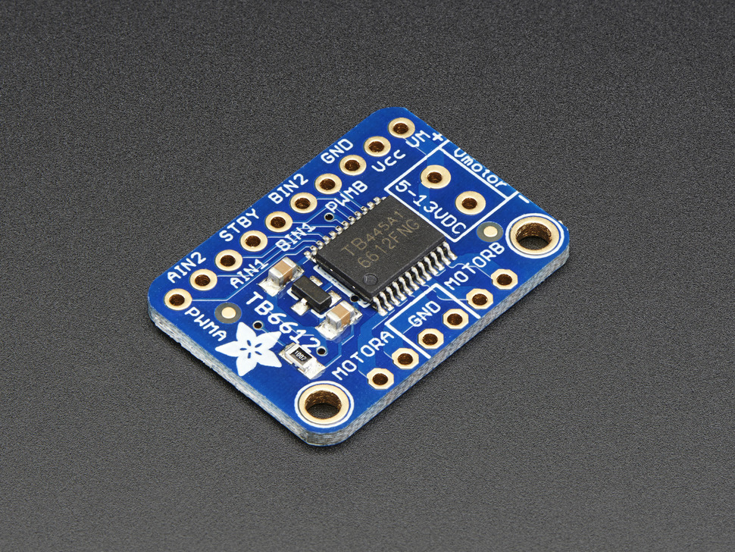
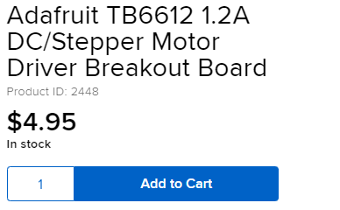
2) Wheeled Robots & Tracked Robots a) Single wheel BB-8 hardware

Slide 9
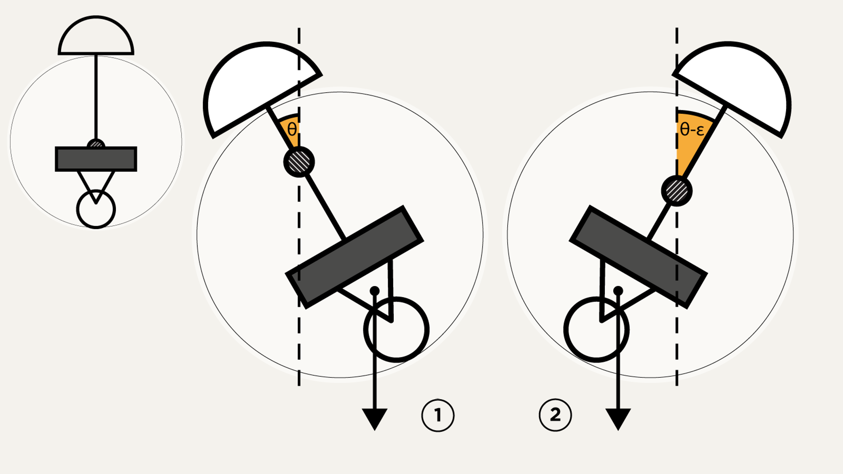
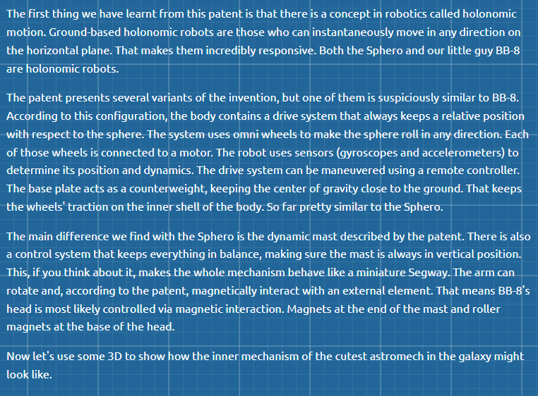
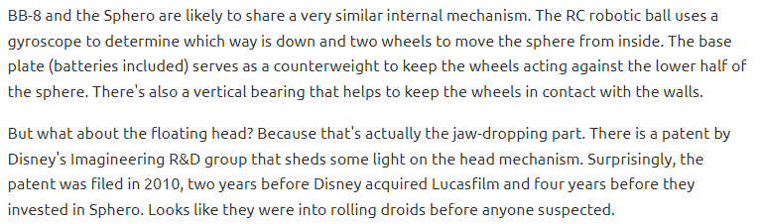
2) Wheeled Robots & Tracked Robots a) Single wheel BB-8 hardware

Slide 10
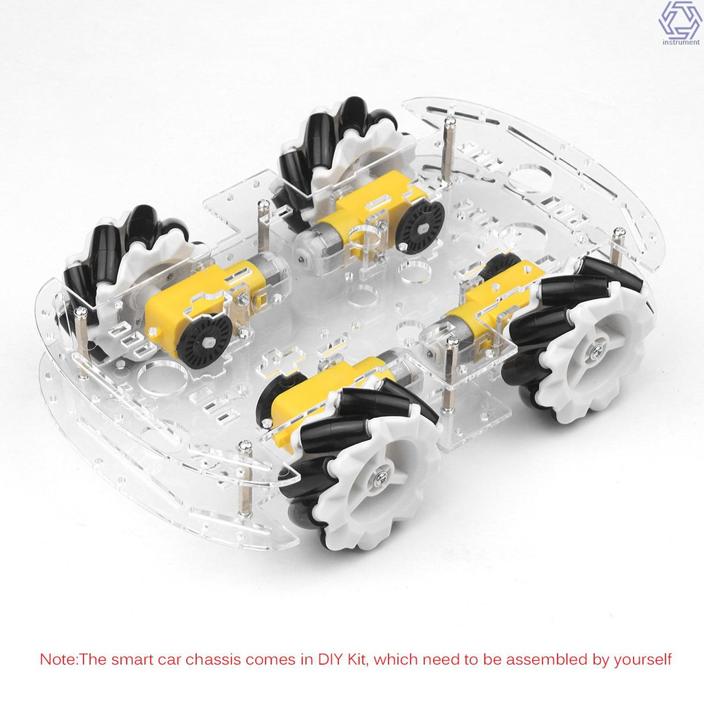
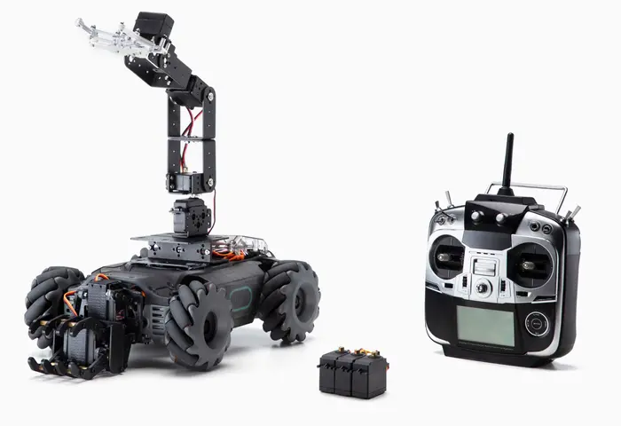
2) Wheeled Robots & Tracked Robots b) 4WD Omni-Directional Mobile Robot

Slide 11
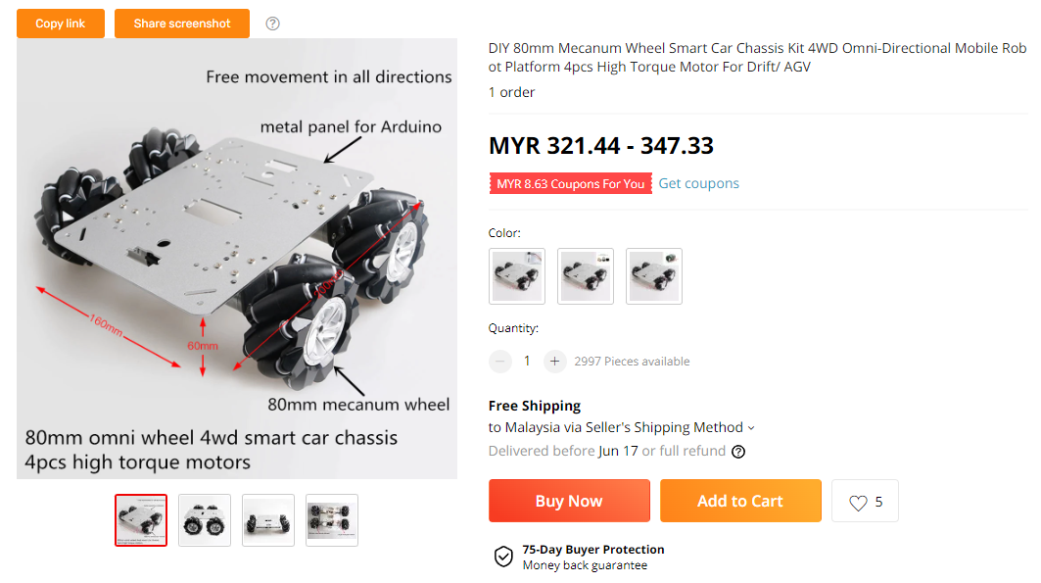
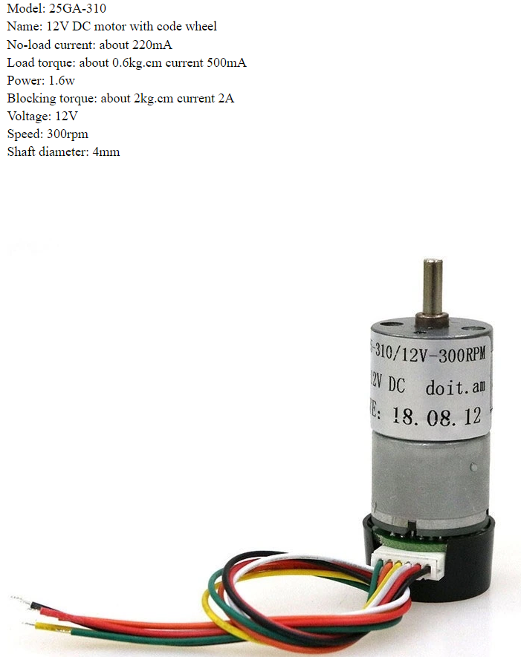
2) Wheeled Robots & Tracked Robots b) 4WD Omni-Directional Mobile Robot

Slide 12
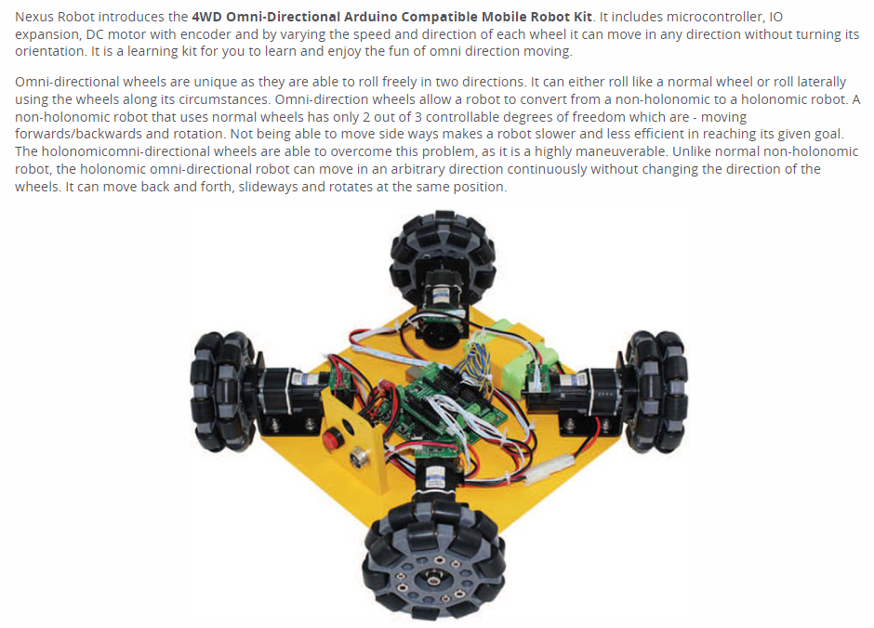
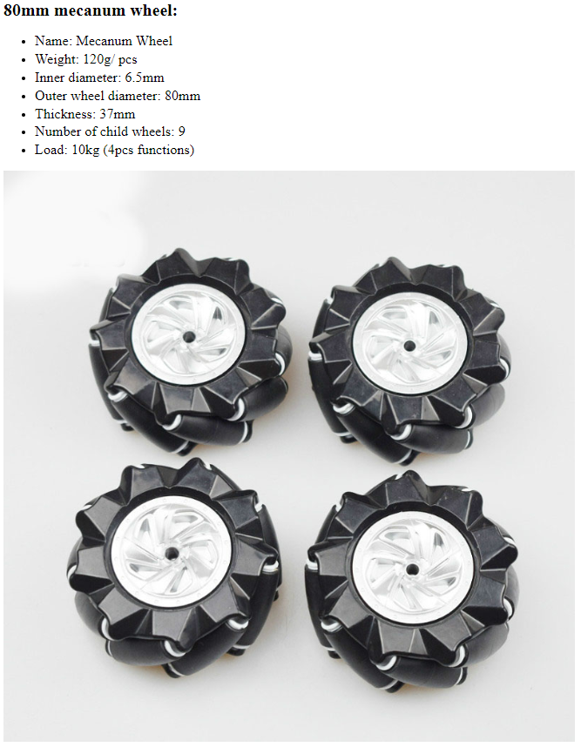
2) Wheeled Robots & Tracked Robots b) 4WD Omni-Directional Mobile Robot

Slide 13
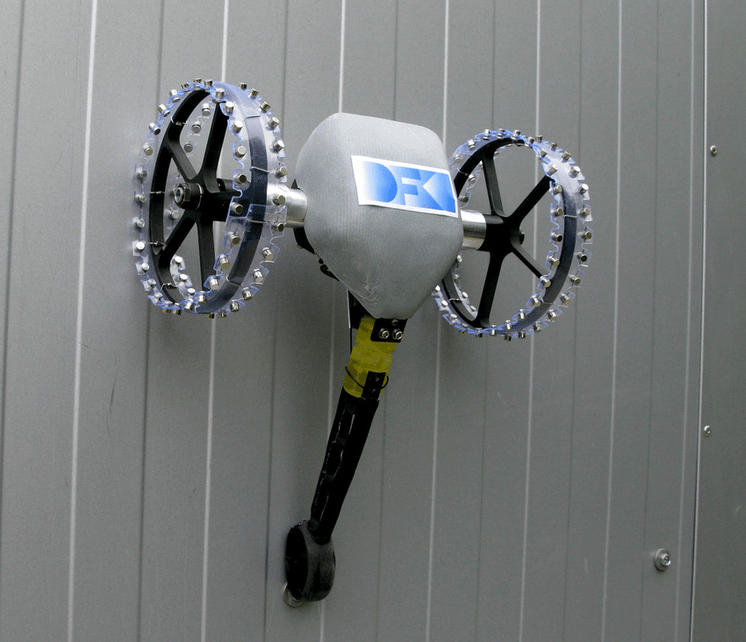
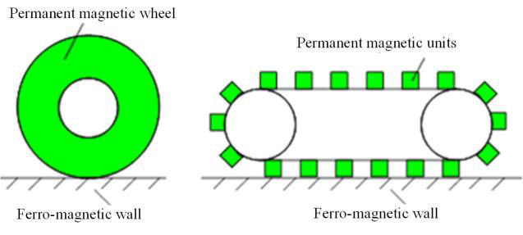
2) Wheeled Robots & Tracked Robots c) Wall Climbing Robot (Metal vs Wall vs Glass)

Slide 14
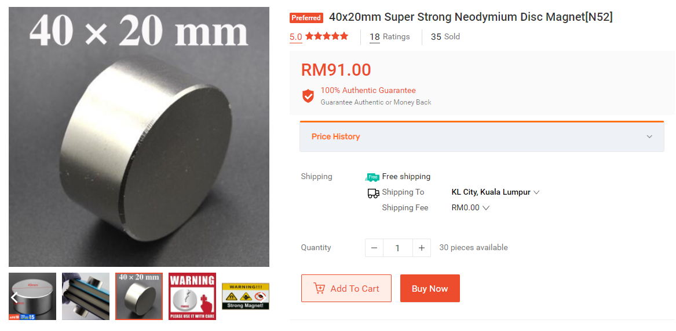
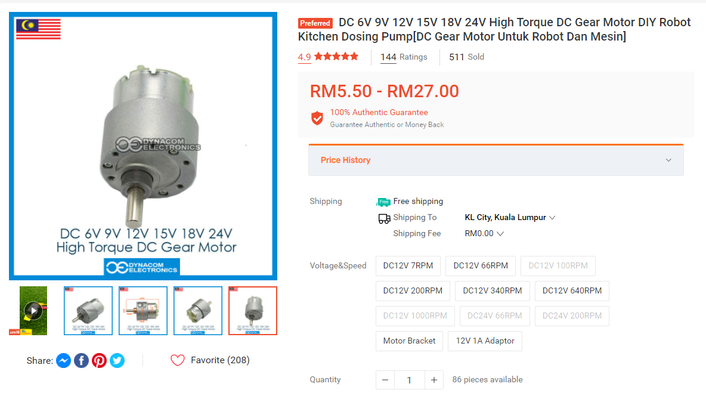
2) Wheeled Robots & Tracked Robots c) Wall Climbing Robot (Metal vs Wall vs Glass)

Slide 15
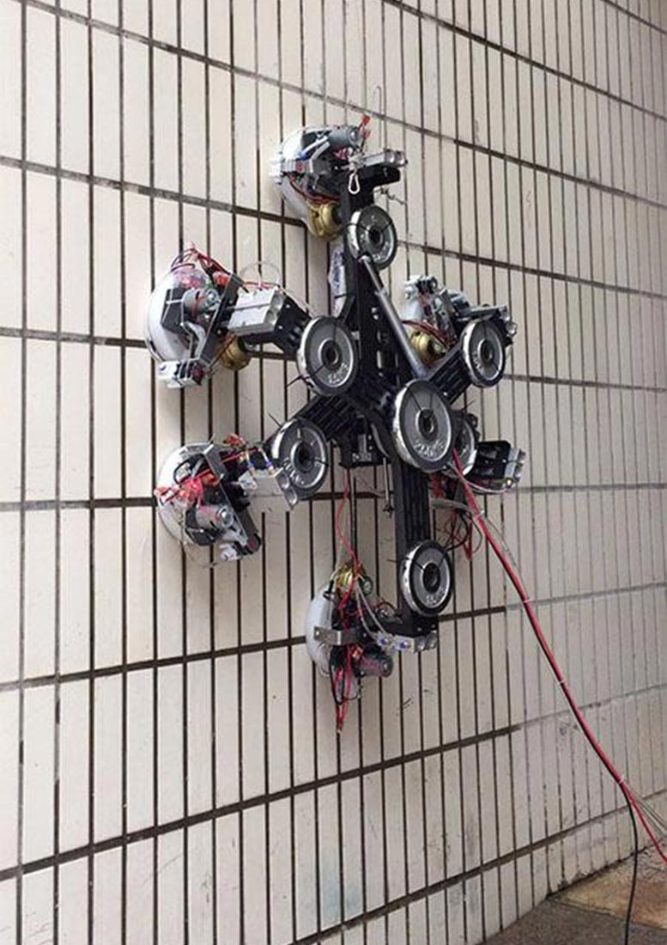
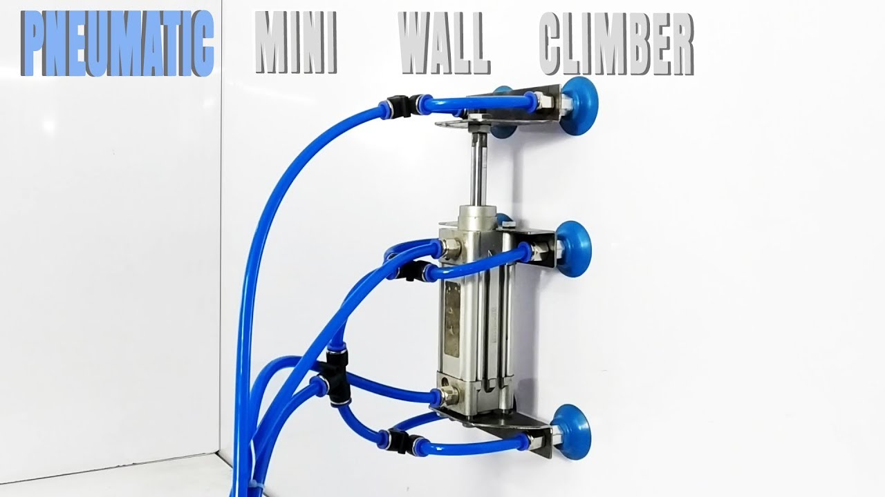
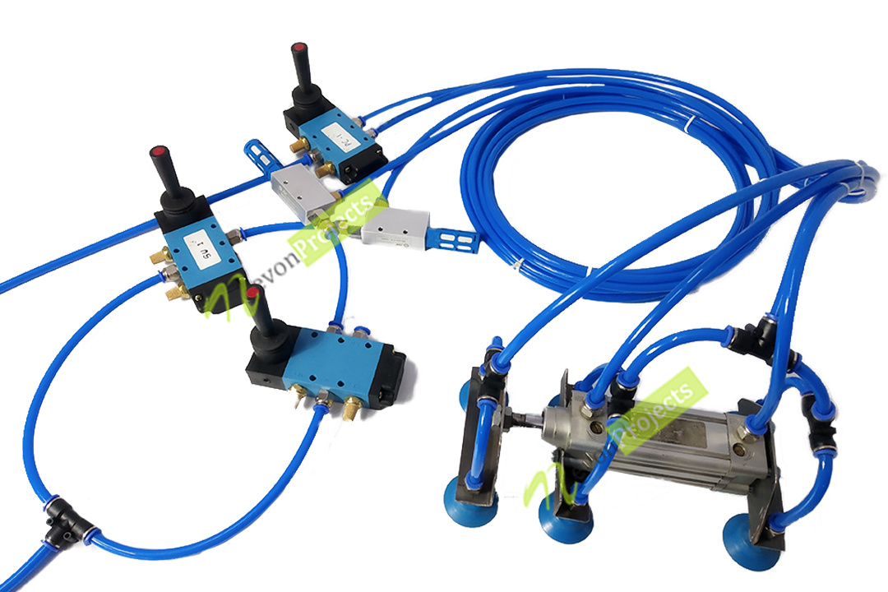
2) Wheeled Robots & Tracked Robots c) Wall Climbing Robot (Metal vs Wall vs Glass)

Slide 16
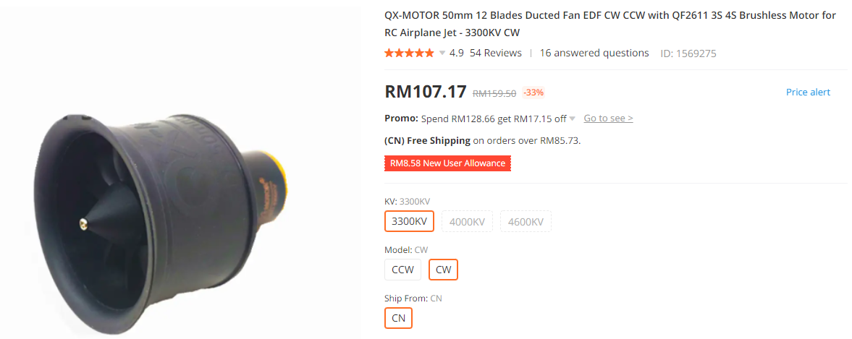
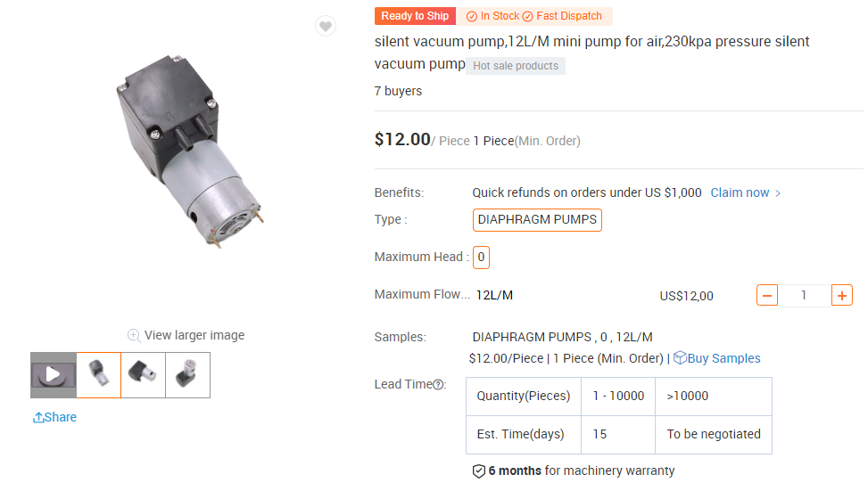
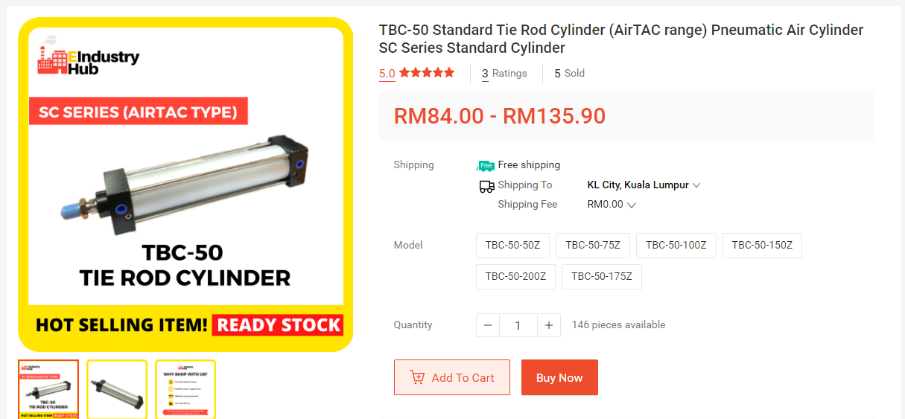
2) Wheeled Robots & Tracked Robots c) Wall Climbing Robot (Metal vs Wall vs Glass)

Slide 17
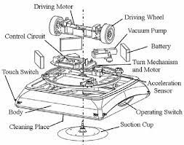
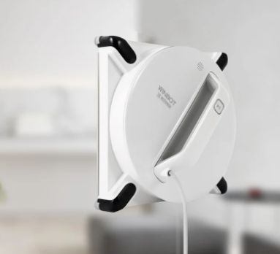
2) Wheeled Robots & Tracked Robots c) Wall Climbing Robot (Metal vs Wall vs Glass)

Slide 18
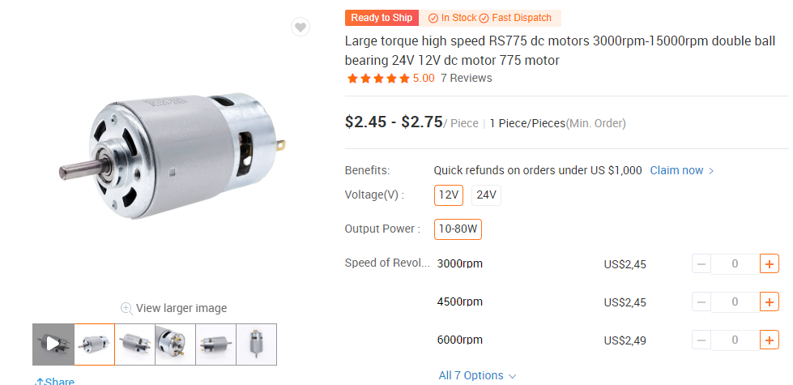
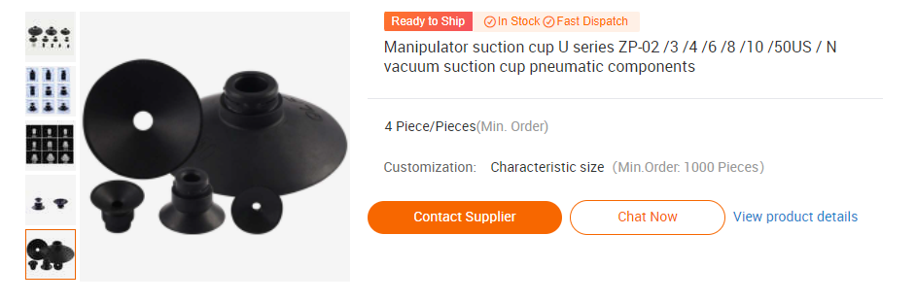
2) Wheeled Robots & Tracked Robots c) Wall Climbing Robot (Metal vs Wall vs Glass)

Slide 19
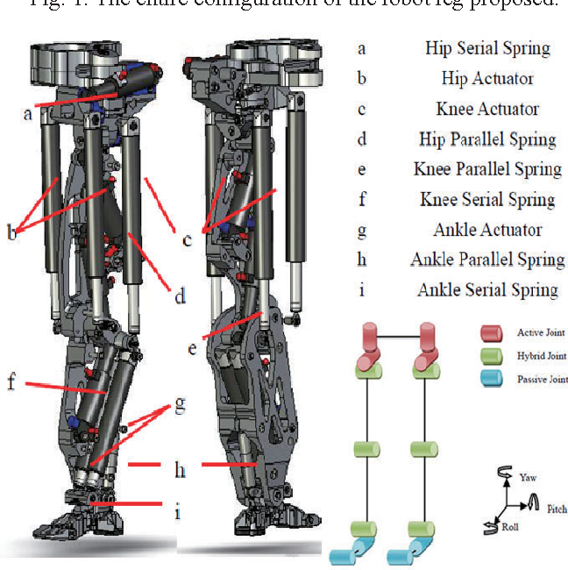
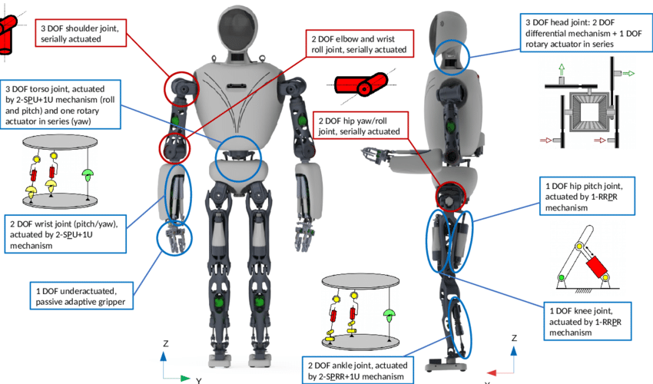
3) Legged a) Humanoid Robot (BIOLOID)

Slide 20
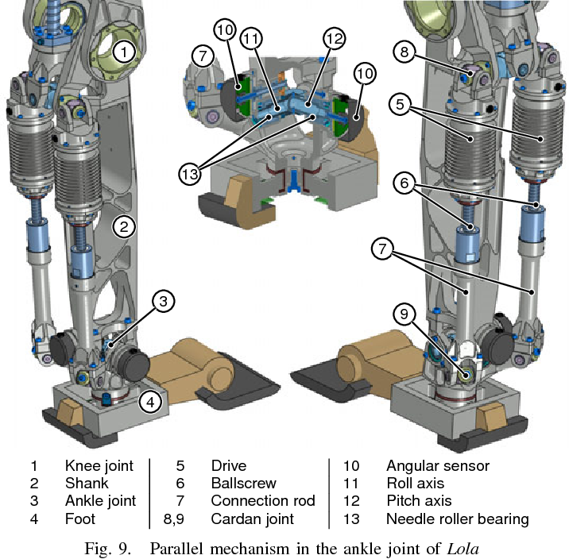
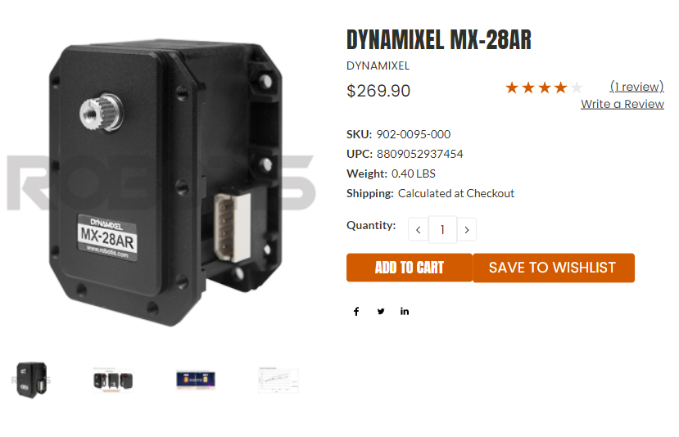
3) Legged a) Humanoid Robot (BIOLOID)

Slide 21
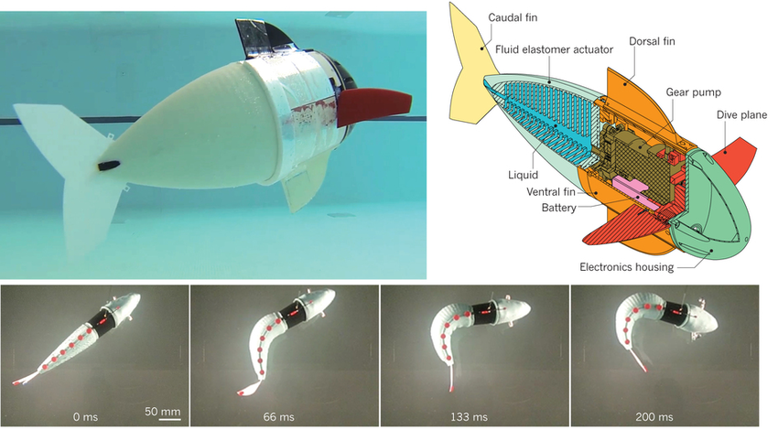
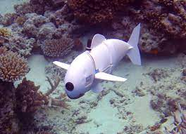
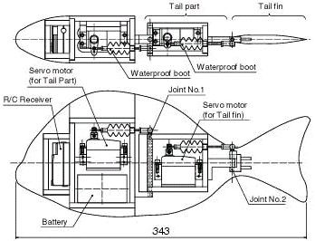
4) Swimming a) Fish robot

Slide 22
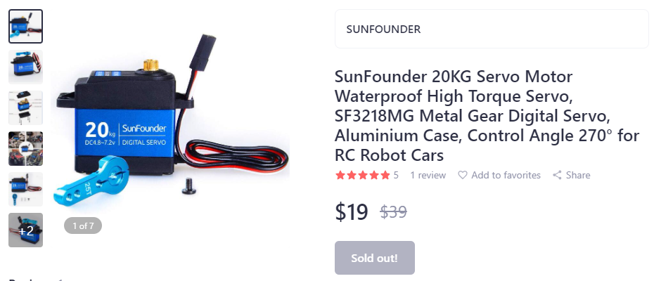
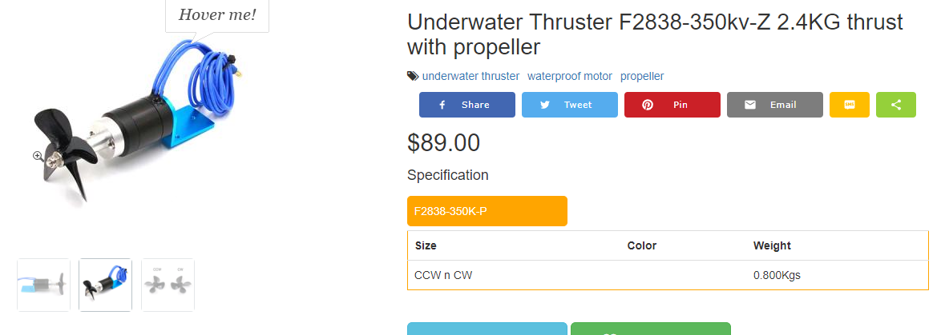
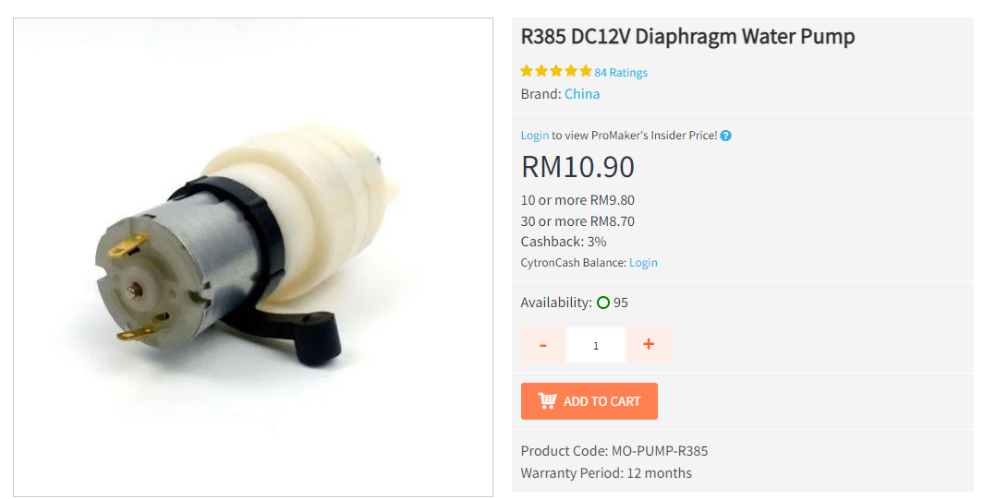
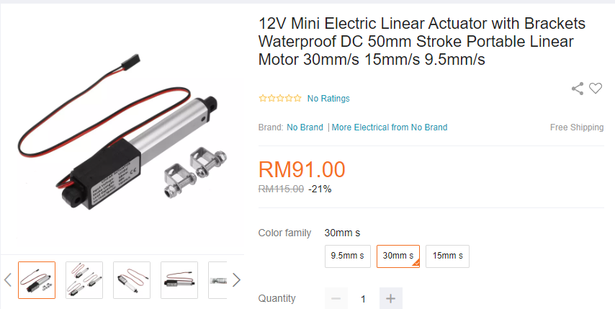
4) Swimming a) Fish robot

Slide 23
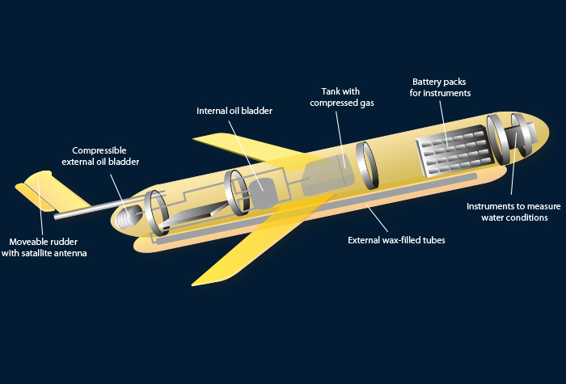
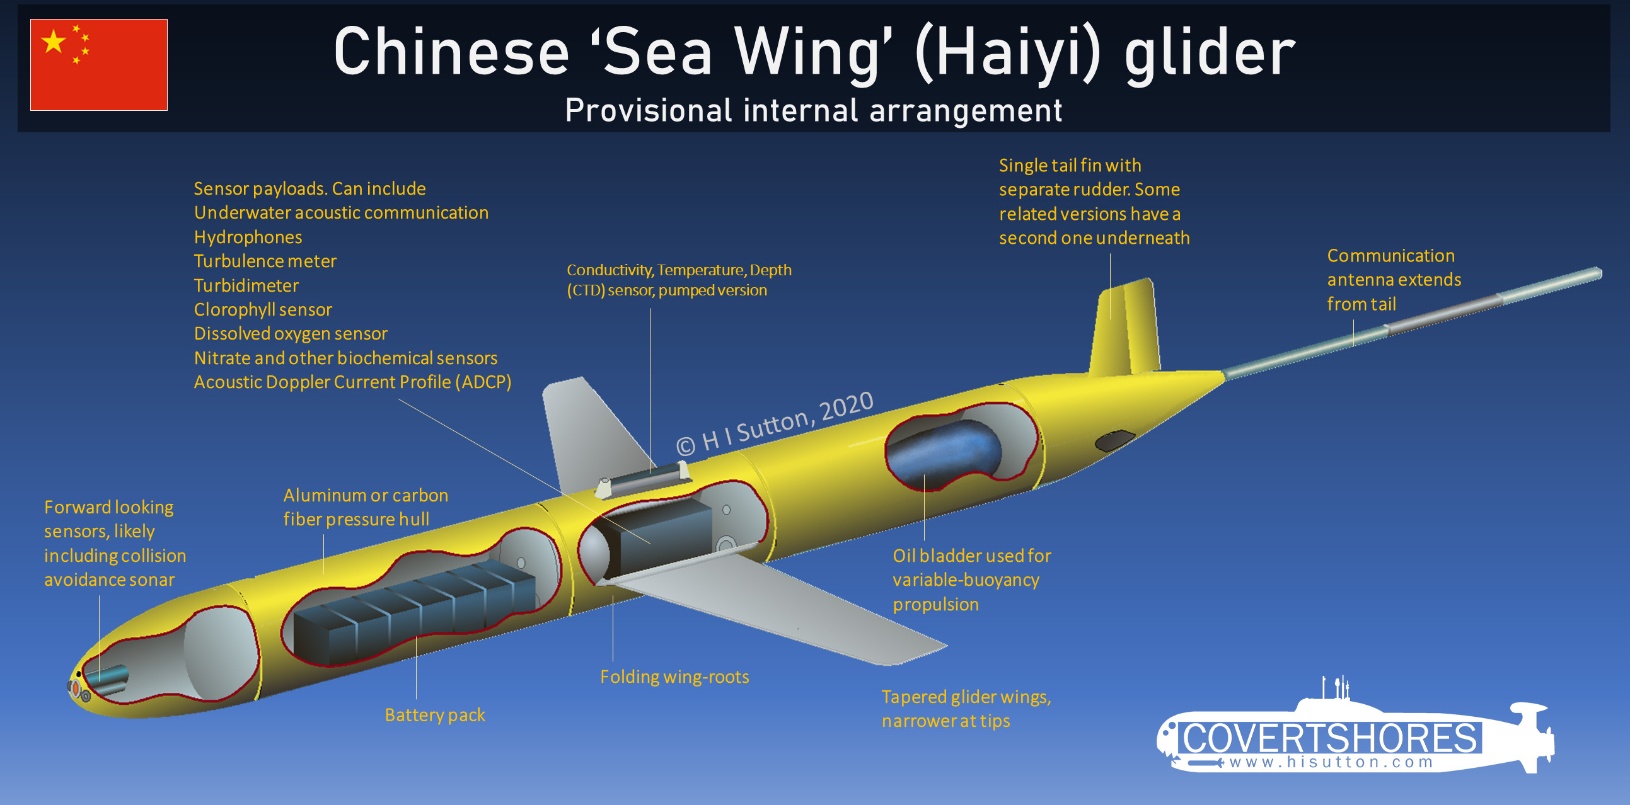
4) Swimming b) Underwater glider robot

Slide 24
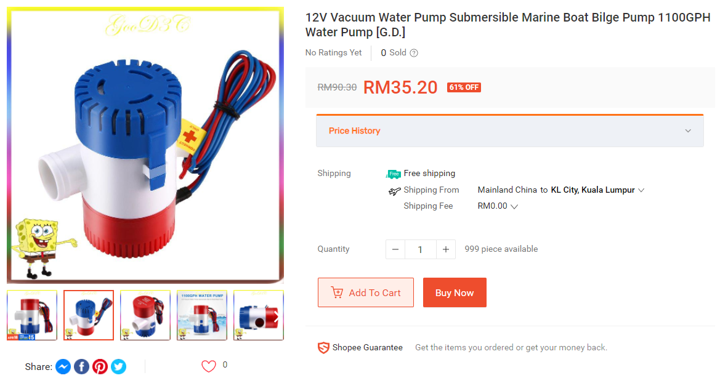
4) Swimming b) Underwater glider robot

Slide 25


5) Others a) Kilobot

Slide 26


5) Others a) Kilobot

Slide 27


5) Others a) Kilobot

Slide 28

5) Others a) Kilobot

